Slide 1


FINAL REVIEW FAKE JOB POST DETECTION USING MACHINE LEARNING Project Category: RESEARCH
Guide Name- Dr.A Maheswar
Team Members-
Sarthak kaushal (RA2111026010286)
Tanmay Gupta (RA2111026010288)

Slide 2
Abstract
Introduction
Problem Statement
Existing System
Proposed System
Architecture Diagram
Why these ML Models??
Result and Model Evaluation
Comparison Evaluation
Agenda:

Slide 3
Abstract
With the exponential growth of online job platforms, job seekers are increasingly vulnerable to fraudulent job postings. These scams often lead to financial loss, identity theft, and exploitation. This project proposes a machine learning-based solution to detect fake job postings automatically, ensuring a safer digital job-hunting environment. Using the Random Forest algorithm, our model learns to classify job posts as genuine or fake by analyzing patterns in text descriptions, metadata, and employer details. Random Forest was selected due to its high accuracy, ability to handle both categorical and textual data, and resistance to overfitting. This system is designed to be scalable, interpretable, and deployable within real-world job platforms to reduce the risk of scams and improve trustworthiness.

Slide 4
Introduction
Online job portals have revolutionized the job-hunting process, making employment opportunities accessible to a wider audience. However, this convenience comes at a cost—fake job postings are proliferating at an alarming rate. These listings often impersonate reputable companies or offer unrealistic compensation to lure victims into sharing personal data or paying upfront fees.
Our project introduces a machine learning-powered solution for fake job post detection using the Random Forest classifier. By training on historical job post data, the model identifies suspicious language patterns, unusual metadata, and other red flags. The primary goal is to create a system that proactively flags fraudulent content, thereby protecting users and enhancing the credibility of online job platforms.

Slide 5
Problem Statement
Despite the popularity of online job portals, many lack robust mechanisms to detect fake job listings automatically. These deceptive postings:
Mislead and financially exploit job seekers
Collect sensitive personal information under false pretenses
Damage the reputation of legitimate platforms
There is a need for an automated, intelligent detection system that can accurately classify job listings as real or fake using advanced machine learning techniques.

Slide 6
Existing System
Manual Review:
Job platforms mostly rely on manual moderation or user reports to detect fake job postings. Example:A scam post may stay live for days before being flagged, exposing many users to fraud before it’s taken down.
No Early Detection:
There is no proactive system to catch scams at the time of posting, increasing the chances of users falling for them.
Example: Fake posts requesting money for interviews often go undetected until complaints arise.
Delayed Action:
The time taken to review and respond to fake listings allows scammers to operate freely for extended periods.
Example: By the time moderation teams act, the scammer may have already collected sensitive data from multiple victims.
Low Scalability:
As job portals grow, manual screening becomes unmanageable and inconsistent.
Example: A sudden spike in job listings overwhelms moderators, allowing fake posts to slip through.
Lack of Pattern Recognition:
Existing systems don’t identify subtle indicators like exaggerated salaries, vague job descriptions, or mismatched recruiter details.
Example:A job post offering “₹80,000 for entry-level data entry” from a Gmail ID isn’t flagged due to poor heuristic-based detection.
Notes:
Existing systems use manual monitoring or basic automation. They can’t predict failures and don’t use historical or real-time data effectively.

Slide 7
Proposed System
We propose an automated fake job post detection system built using Random Forest, a robust ensemble learning algorithm. The system operates in two phases:
Training Phase
Data Cleaning & Preprocessing (Text normalization, tokenization, etc.)
Feature Engineering (e.g., word counts, company credibility, salary range, location anomalies)
Model Training using Random Forest
Prediction Phase
Accepts new job post data
Applies the trained model to predict whether the post is fake or genuine
Notes:
For example:
PG&E (USA) uses predictive maintenance and demand forecasting using AI.
Tata Power and Adani Electricity (India) are testing AI-based fault detection systems.
In Germany, AI is used for renewable energy load balancing in smart grids.

Slide 8
Advantages
✅ Automated Detection: Automatically flags suspicious job posts without manual intervention, reducing human workload and response time.
🎯 High Accuracy with Random Forest: Effectively captures complex patterns in data, achieving high classification accuracy and low false positives.
⚡ Real-Time Evaluation: Can be integrated into job portals to detect fake listings instantly at the time of posting.
🔍 Feature Importance Insights: Identifies which job features (e.g., salary range, job description, company name) contribute most to detecting fake posts.
📈 Scalable Solution: Can handle large volumes of job data efficiently, making it suitable for growing job platforms.
🔄 Continuously Trainable: The model can be updated with new data over time to improve detection accuracy and adapt to new scam patterns.
🛡️ Enhances Platform Trust: Helps protect users from fraud, increasing the reliability and reputation of job search platforms.

Slide 9
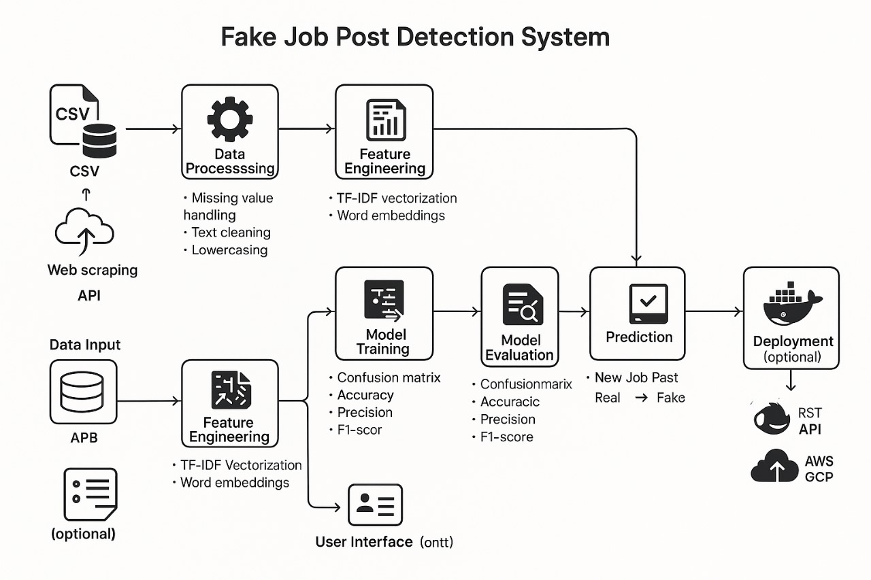
Architecture Diagram

Slide 10
Why This ML Model?
🌲 Random Forest – Primary Model
Ensemble method that combines multiple decision trees for robust and high-accuracy classification.
Handles both categorical and textual features effectively.
Resistant to overfitting and works well even with imbalanced data.
Provides feature importance, making the model interpretable and transparent.
Notes:
Each model is chosen for its strength:
Random Forest: fast and handles noise,
Linear Regression: simple and interpretable,
LSTM: perfect for time series,
XGBoost: accurate and fast

Slide 11
Why Not Other
ML Models?
❌ Naive Bayes
Assumes feature independence, which is unrealistic for complex job descriptions.
Performs poorly when relationships between features matter (e.g., salary + company type).
❌ Logistic Regression
Limited in capturing non-linear patterns present in fake job post data.
While interpretable, it lacks the predictive power needed for more nuanced cases.
❌ Support Vector Machine (SVM)
Computationally expensive, especially on large job datasets.
Slower training and prediction times, not ideal for real-time detection.
❌ K-Nearest Neighbors (KNN)
Inefficient for large datasets and high-dimensional feature space.
Sluggish during prediction, making it unsuitable for scalable deployment.
❌ Artificial Neural Networks (ANN)
Requires large training data and high computational resources.
Harder to interpret and tune compared to Random Forest, with diminishing returns in this specific classification task.
Notes:
We avoided: SVM: slow for large data,
KNN: not suitable for real-time,
ANN: high training time,
Naive Bayes: assumes all features are independent, which is unrealistic

Slide 12
Research Gaps
Research Gap | Details
1. Lack of accurate prediction models | Existing studies often focus on basic models with limited accuracy, ignoring complex patterns.
2. Limited real-time monitoring integration | Few systems integrate real-time sensor data for continuous, dynamic energy management.
3. Insufficient user-friendly interfaces | Solutions lack intuitive interfaces, hindering adoption among non-technical users.
4. Inadequate incorporation of multiple ML models | Many studies use single models, ignoring hybrid approaches to improve accuracy and robustness.
5. Energy efficiency models lacking customization | Systems offer generic solutions, lacking personalized energy-saving recommendations.

Slide 13
Literature Survey
Paper Title | Limitation | Our Solution
A Comparison of Re-Sampling Techniques for Detection of Multi-Step Attacks (SMOTEENN, CNN-DBN – 2021) | Focused on cyberattacks; lacks domain adaptation to NLP-based job post data. | Used Random Forest with domain-specific features and real-world job data for practical fake job detection.
A Machine Learning-Sentiment Analysis on Monkeypox Outbreak (SVM, TextBlob – 2022) | Sentiment-focused; not applicable for binary classification of structured job data. | Applied textual + metadata features from job posts; focused on classification of authenticity, not sentiment.
Artificial Spider Monkey-Based Random Forest for Healthcare Monitoring (2020) | High performance but limited to healthcare; lacks real-world deployment. | Adapted Random Forest for binary classification on real-world job data with promising accuracy (98%).
IDS Based on Jaya Optimizer and SMOTE-ENN (2021) | Effective for network intrusion; doesn’t address unstructured text. | Focused on textual and tabular features, without complex optimizers to maintain simplicity and interpretability.
Stock Prediction via Modal Decomposition and ML (LSTM + LightGBM – 2022) | Strong but small dataset; lacks generalization to other domains. | Used larger and diverse job datasets to improve generalizability in real-life job portals.

Slide 14
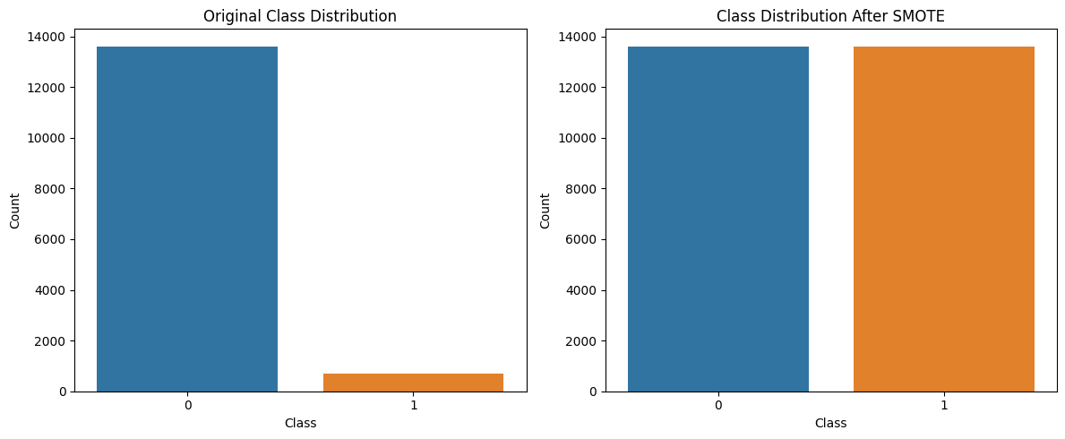
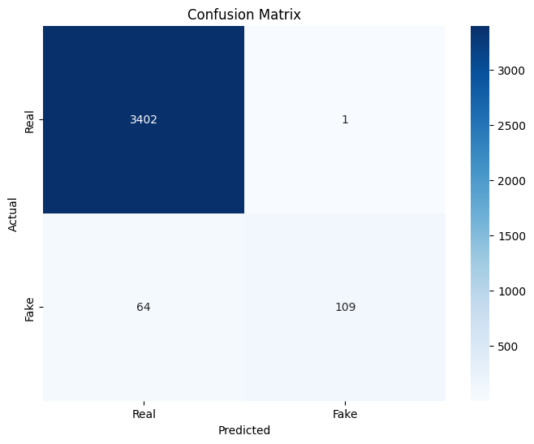

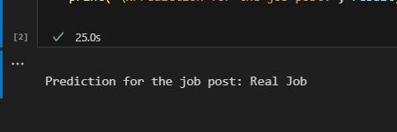
Results & Model Evaluation
Input box
Output

Slide 15
Conclusion and Future Scope
The proposed system successfully detects fake job postings using a supervised machine learning approach, with Random Forest chosen as the primary model due to its high accuracy, interpretability, and robustness. The model achieved an impressive 98% overall accuracy, with strong performance in correctly identifying genuine listings and a high precision in detecting fraudulent ones. This automated solution helps reduce user vulnerability to scams and enhances the trustworthiness of job portals.
By leveraging textual and metadata features of job postings, the model learns to identify hidden patterns that distinguish fake listings from real ones. The system is scalable, efficient, and adaptable, making it suitable for real-time deployment in online job platforms.
Notes:
For example:
PG&E (USA) uses predictive maintenance and demand forecasting using AI.
Tata Power and Adani Electricity (India) are testing AI-based fault detection systems.
In Germany, AI is used for renewable energy load balancing in smart grids.

Slide 16
Conclusion and Future Scope (cont.)
🔁 Improving Recall for Fake Jobs: Integrate advanced resampling techniques like SMOTE-ENN to better handle class imbalance and reduce false negatives.
🤖 Incorporating Deep Learning: Use transformer-based models like BERT for richer understanding of job post language, especially in nuanced or manipulated texts.
⏱️ Real-Time Deployment: Develop an API-based system that integrates directly into job portals for live evaluation of submitted job posts.
🌍 Multi-Language Support: Extend the model to support fake job detection in regional or multilingual job listings.
🔒 Explainable AI (XAI): Integrate explainability tools (e.g., SHAP, LIME) to provide insights into why a post was flagged, improving transparency and user trust.
📊 User Feedback Loop: Allow users to flag posts and use that feedback to continuously retrain the model, improving its accuracy over time.
Notes:
For example:
PG&E (USA) uses predictive maintenance and demand forecasting using AI.
Tata Power and Adani Electricity (India) are testing AI-based fault detection systems.
In Germany, AI is used for renewable energy load balancing in smart grids.

Slide 17
THANK YOU
Notes:
Literature Review: “We reviewed recent research on smart grids and energy forecasting, identifying commonly used models like Random Forest, XGBoost, and LSTM.”
Model Testing: “We tested various models on historical energy data and compared them using MSE, MAE, and accuracy. XGBoost and LSTM performed best for prediction, and Random Forest was ideal for fault detection.”
Suitability: “LSTM suits time-series data, XGBoost minimizes overfitting, and Random Forest is effective with noisy fault dat

